Slide 1
STORAGE CLASSES
Introduction and Features of storage classes

Slide 2
STORAGE CLASSES
In C programming every variable is having two properties:
Type - refers to the data type of a variable
Storage class - determines the scope, visibility and lifetime of a variable.
Scope : The scope of a variable is the part of the program within
Which the variable can be accessed.
Visibility : The scope describes the visibility of a variable. A variable
is visible within its scope and invisible or hidden outside it.
Life Time : The lifetime of a variable is the interval of time between
the memory allocation and release of the memory been allocated for a
variable.

Slide 3
STORAGE CLASSES
Four types of storage classes,
auto
external
static
register

Slide 4
Auto and Static Storage classes

Slide 5
Automatic - STORAGE CLASS (Local Variables)
Automatic variables are local variables that are declared with in a block/a function .
It can be accessed only inside the program block in which it is declared.
It is stored in stack in memory.
Default value is any random garbage value.
The life time is till the control remains within the block in which the variable is defined.

Slide 6
Automatic - STORAGE CLASS (Cont …) auto Keyword
Automatic variables declared using auto keyword
Default storage class of all local variables.
Example :
void main()
{
auto int a; or int a; // Both are same
}

Slide 7
Automatic - STORAGE CLASS (Cont…) How it works ?
void main()
{
int n1; // n1 is a local variable to main()
}
void func()
{
auto int n2; // n2 is local variable to func()
}

Slide 8
Automatic STORAGE CLASS (Cont …) EXAMPLE
#include <stdio.h>
void main( )
{
auto int j = 1;
{
auto int j= 2;
{
auto int j = 3;
printf ( " %d ", j);
}
printf ( "\t %d ",j);
}
printf( "%d\n", j);
}
Output:
3 2 1

Slide 9
Static– STORAGE CLASS
A static variable tells the compiler to persist/save the variable until the end of program.
A local or a global variable can be a static variable.
Static local variable is declared with in a function/block. Its life time is till the program terminates.
Static global variable is declared outside of all the functions. Its life time is till the program terminates.
Default value is 0
It is stored in the data segment of the memory.

Slide 10
Static – STORAGE CLASS (Cont…)
Static Variables are declared using static keyword.
#include<stdio.h>
void test(); //Function declaration
void main()
{
test();
test();
test();
}
void test()
{
int a = 0; // a is local variable
a = a + 1;
printf("%d\t",a);
}
#include<stdio.h>
void test(); /Function declaration
void main()
{
test();
test();
test();
}
void test()
{
static int a = 0; //a is static local variable
a = a + 1;
printf("%d\t",a);
}
Output:
1 2 3
Output:
1 1 1

Slide 11
External and
Register Storage classes

Slide 12
External – STORAGE CLASS (Global Variables)
Variables that are declared outside of all functions are known as external or global variables.
They are accessible from any other function inside the program.
Default value is zero.
The value is assigned to it in a different block and this can be overwritten/changed in a different block .
The lifetime is till the program terminates.
It is stored in the data segment of the main memory.

Slide 13
EXTERNAL – STORAGE CLASS GLOBAL VARIABLE (Cont…) EXAMPLE
#include <stdio.h>
void display();
int n = 5; // global variable
int main()
{ ++n;
display();
return 0;
}
void display()
{
++n;
printf("n = %d", n);
}
Output:
n=7

Slide 14
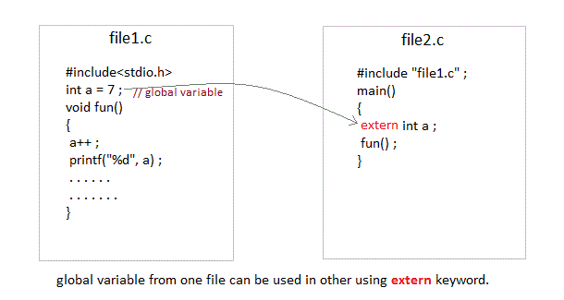
External – STORAGE CLASS (Cont..) extern KEYWORD USAGE
To access a global variable declared in file1 in a different file file2, keyword
extern is used in file2 to indicate that the external variable is declared in another file.

Slide 15
External – STORAGE CLASS (Cont..) EXAMPLE
Problem when extern is not used
int main() { a = 10; //Error: cannot find definition of variable 'a' printf("%d", a); }
Example using extern in same file
int main() { extern int x; //informs the compiler that it is defined somewhere else x = 10; printf("%d", x); } int x; //Global variable x

Slide 16
Register – STORAGE CLASS
Register variables are very similar to the auto variables. The difference is the storage. Register variables are stored in CPU registers. Register variables are accessed faster than the local variables.
Default value of the variable is any random garbage value.
Lifetime is till the end of function/method block, in which the variable is defined.
NOTE: We can never get the address of such variables.

Slide 17
Register – STORAGE CLASS
Register variables declared using register keyword
Example :
void main()
{
register int a;
}

Slide 18
Register – STORAGE CLASS EXAMPLE
Example 1:
#include <stdio.h>
void main()
{
register int a;
printf("%d",a);
}
Example 2:
#include <stdio.h>
void main()
{
register int a = 0;
printf("%u“, &a);
}
Example 1:
Output :
283456
Explanation: variable a is allocated memory in the CPU register.
The initial default value of a is random garbage value.
Example 2:
Output :
main.c:5:5: error: address of register variable a requested
Explanation:
This will give a compile time error since we can not access the address of a register variable.

Slide 19
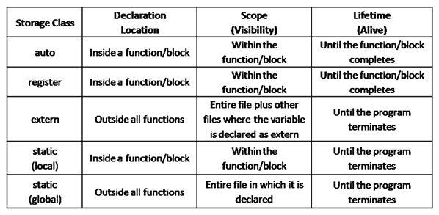
STORAGE CLASSES -A RECAP

